Slide 1


Capstone Demo Day
AN OVERVIEW OF KEY PROJECT DELIVERABLES

Slide 2


Welcome to Capstone Demo Day!
Goal: Showcase the culmination of your project
🎯 Key Takeaways:
Present a live demo of your deployed Streamlit app.
Reflect on the learning journey and challenges.
Submit final project with GitHub repo, live Streamlit link, and technical report.

Slide 3



Live Demo Requirements for Capstone Project
Core Demo Components:
End-to-End App Functionality
Demonstrate user authentication, predictions, data uploads, and historical tracking.
Live Interactions
Include login, file upload, model predictions, and explainability outputs.
Deployed URL
Ensure your Streamlit Cloud URL is live and accessible.

Slide 4
Live Demo Requirements for Capstone Project
Suggested 10-Minute Flow:
App Overview: 2 minutes
Live Walkthrough: 5 minutes
Challenges & Lessons: 2 minutes
Future Work: 1 minute

Slide 5
Live Demo Requirements for Capstone Project
Presentation Tips:
Practice twice for smooth flow.
Open all necessary tabs/files before starting.

Slide 6



Reflection & Lessons Learned
Reflect in your report:
Difficult components (e.g., handling .env, prediction accuracy)
Resolution methods (e.g., using logs, consulting documentation)
What would you add with more time? (e.g., additional AI models, enhanced UI)
Insights Gained
Reflecting on the experience, it's clear that teamwork and perseverance are essential for success in any capstone project.
Throughout this module, I have acquired valuable knowledge about machine learning processes and gained practical insights into the real-world applications of these technologies.
Example:

Slide 7


Final Deliverables Checklist
Ensure all items are completed before submission:
A. GitHub Repository:
main_app.py
.streamlit/secrets.toml
models/ and scripts/
.github/workflows/retrain.yml
requirements.txt
README.md (include deployed app URL)
B. Final project poster (1 page)
Project summary, methodology, architecture diagram, results, insights, and lessons learned
C. Short report (300 words)
What you built, what you learned, and how you grew
D. Submission Checklist:
GitHub repo with commit history
Live app link on Streamlit Cloud
Final PPT project poster
Completed “.ipynb” and “.py” files

Slide 8

Lab Task, Key Terms & Concepts
Paste your deployed app link.
Add screenshots from your app (login, prediction screens, etc).
Include SHAP or MAE plot from your history.
Answer reflection questions:
What was the most technically rewarding part of the project?
How will you maintain your deployed app?
Term | Definition
Capstone Project | Final comprehensive task combining all lessons
Deployment | Putting a product into production or public access
Version Control | Tracking code changes using Git
SHAP | Explains model predictions (Shapley Additive Explanations)

Slide 9

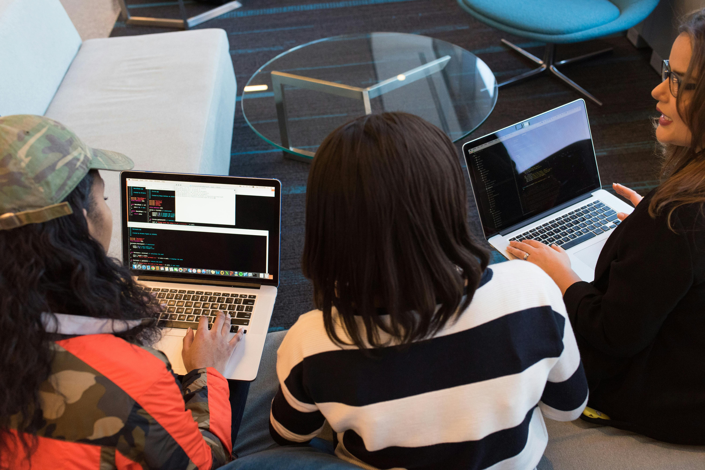
Understanding key terms is crucial for your success in mastering machine learning concepts and applications.

Slide 10


Thank You!

